Slide 1
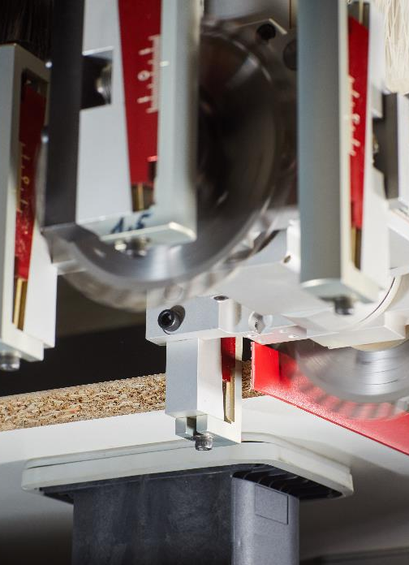
Der Markt für Holzbearbeitungsmaschinen – Russland
Final Figures 2019
German Woodworking Machinery
May 4th 2020
VDMA Woodworking Machinery

Slide 2
Final Results 2019
Woodworking Machinery in Germany in bn Euro
 | 2019 | 2018 | YOY [%]
Production (Mrd. Euro) | 3,36 | 3,34 | +0,6
Export (Mrd. Euro) | 2,40 | 2,47 | -3,0
Import (Mio. Euro) | 556 | 588 | -5,4
Source: VDMA, Statistisches Bundesamt

Slide 3
Production of Woodworking Machinery in Germany
Bn Euro
Source: VDMA, Statistisches Bundesamt

Slide 4
German Exports of Woodworking Machinery
Bn Euro
Source: VDMA, Statistisches Bundesamt

Slide 5
German Exports Woodworking Machinery
Top 15 2019/2018
Mn Euro
German Export 2019: 2,40 bn. Euro (-3,0% yoy)
Source: VDMA, Statistisches Bundesamt

Slide 6
German Import of Woodworking Machinery
Mn Euro
Source: VDMA, Statistisches Bundesamt

Slide 7
German Import of Woodworking Machinery
Top 10 2019/2018
Mn Euro
German Import 2019: 588 Mn. Euro (-5,3% yoy)
Source: VDMA, Statistisches Bundesamt

Slide 8
Q&A?
Contact:
Dominik Wolfschuetz
VDMA Woodworking Machinery
+49 69 6603 1819
dominik.wolfschuetz@vdma.org

